Slide 1
Django Members App: Step-by-Step Guide
Complete Setup and CRUD Implementation

Slide 2
1. Install Django and Virtual Environment
Install Django: pip install django
(Optional) Create virtual environment:
python -m venv myenv
Activate: myenv\Scripts\activate

Slide 3
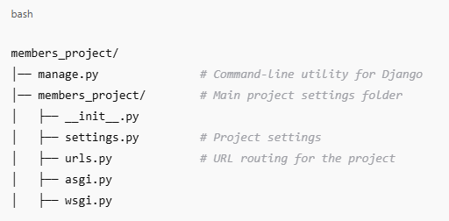
2. Create a Django Project
Run: django-admin startproject members_project
Navigate: cd members_project
python manage.py createsuperuser

Slide 4
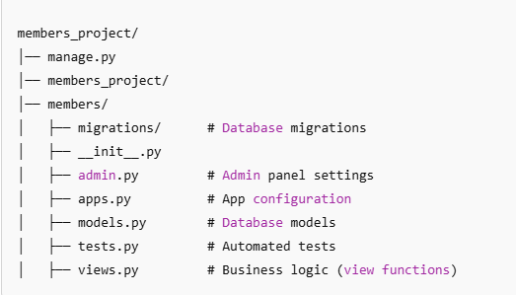
3. Create a Django App
Run: python manage.py startapp members
Adds new folder: members/

Slide 5
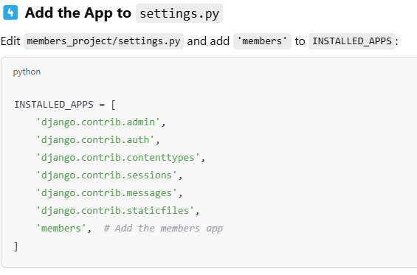
4. Define the Member Model

Slide 6
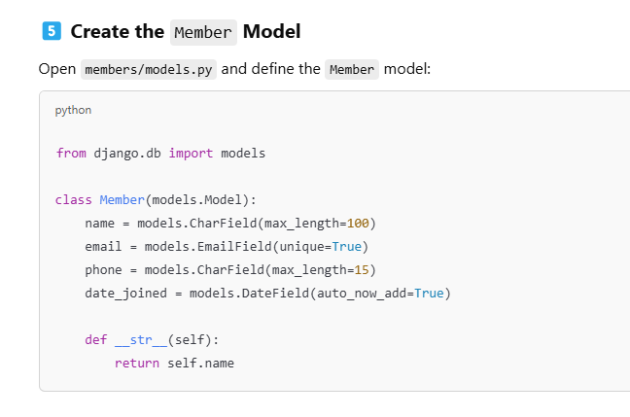

Slide 7
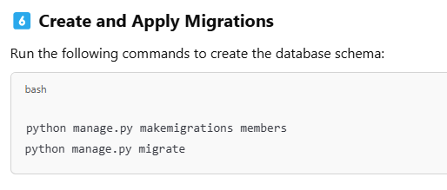

Slide 8
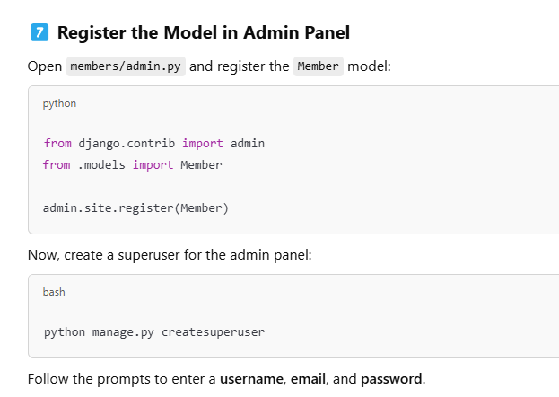

Slide 9
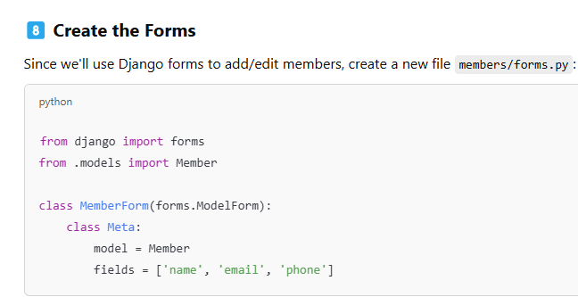

Slide 10
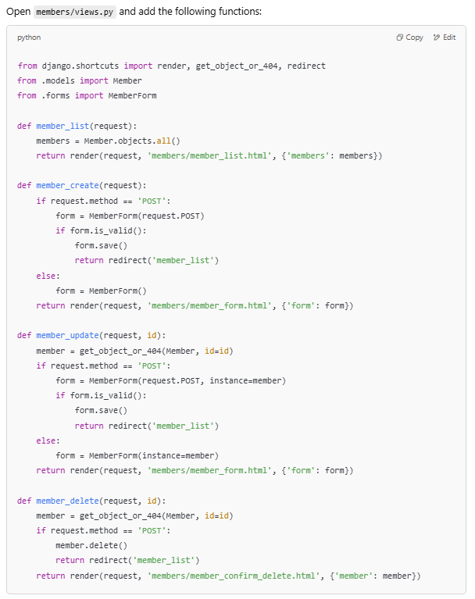

Slide 11
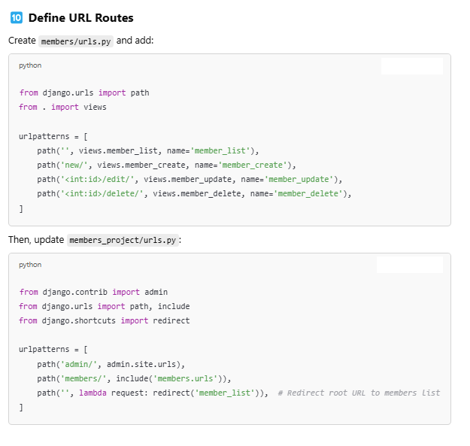

Slide 12
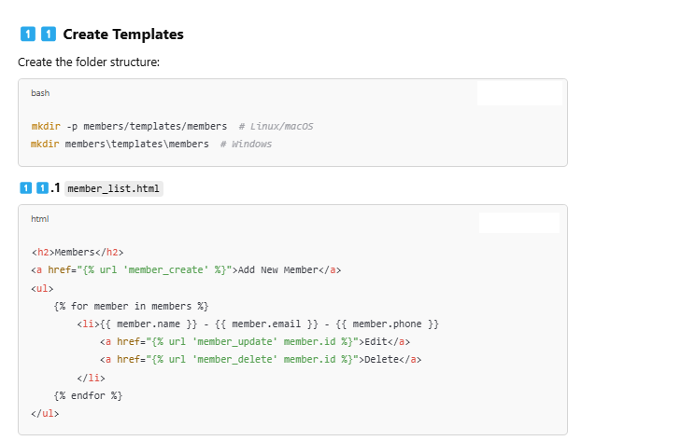

Slide 13
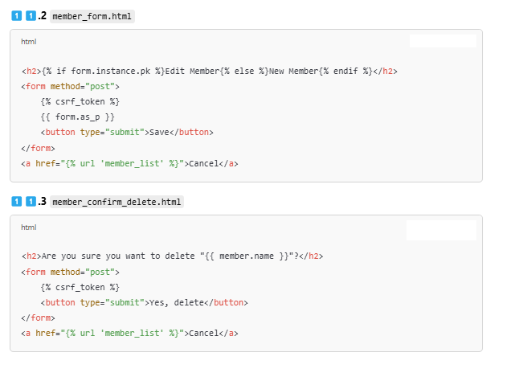

Slide 14
